Slide 1
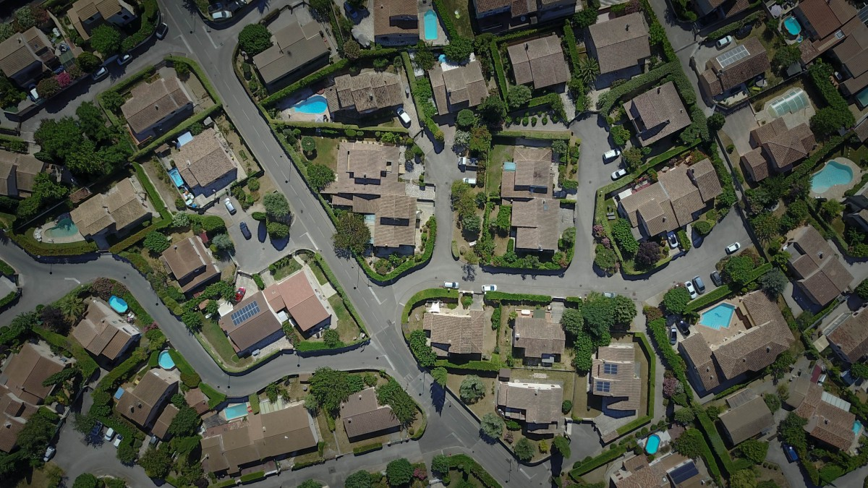
Home values Heat map
Alec Henderson, Andrew Paton, Dan Tinarwo, Karina Horna, Reinhard Ndlovu

Slide 2
01
Data Scraping Process
02
Data Cleaning Process
Presentation
Agenda
03
Google API
04
Mongo DB/Flask
05
Leaflet Map Creation

Slide 3
Executive Summary
Throughout this study we evaluated the Midland housing prices focusing our heat map on home values. The data was aggregated and pulled into a database which will be called by end users to deliver that data via an API call to a JavaScript created heat map.
01
02
03
Cleaning the Data & Creating the Database
API Call & JavaScript Heat Map
Data Source
Our data source features over 60,000 Midland housing data points that was pulled from the Midland County District Appraisal Website.
The data was cleaned by dropping columns and null values that weren’t needed and ensuring the CSV was readable for our next step. The database was created by importing the data to Mongo DB and ensuring the correct filters were applied to filter the data to be readable by the API.
A G Maps API was created for the project to pull against the database and transfer the data to our heat map and display the newly generated map objects

Slide 4
Data scraping & Cleaning
The section below will give an overview of the scraping and cleaning process
Website
Collection method
aggregation
source
scraping
cleaning
Midland County Database
Scraping Process
Cleaning Method
Identified the Midland County Housing database as a great source for our data.
We leveraged a scraping library to retrieve the data
Used a a scraping library from python to collect data from the County Appraisal site.
Merged multiple CSV data files into a single dataframe.

Slide 5
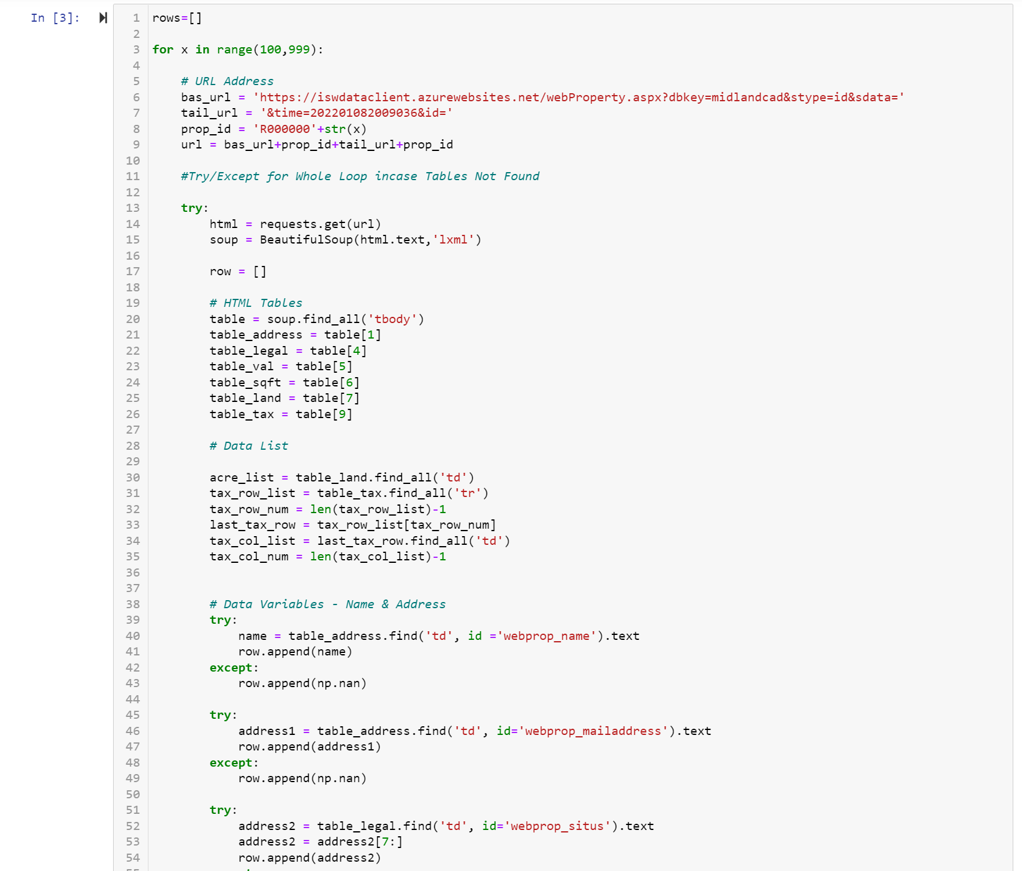
GATHERING THE DATA
DATA SOURCE & WEB SCRAPPING CODE
Working Process
Andrew to Insert Picture here
FORMAT THE SIZE TO THE DETAILS BELOW FOR CONSISTENCY
Size 4.19 x 4.98
DATA SOURCE & SCRAPPING PROCESS
Used a BeautifulSoup library to scrape Midland County’s Appraisal Districts website.
Created For loop the URL ID number to run from 1 - 60,000 records.
Scraped the website for property and building values, and square footage.
The script returned a city value if “Midland” was found in the address.
Saved the dataframe to a CSV file.

Slide 6
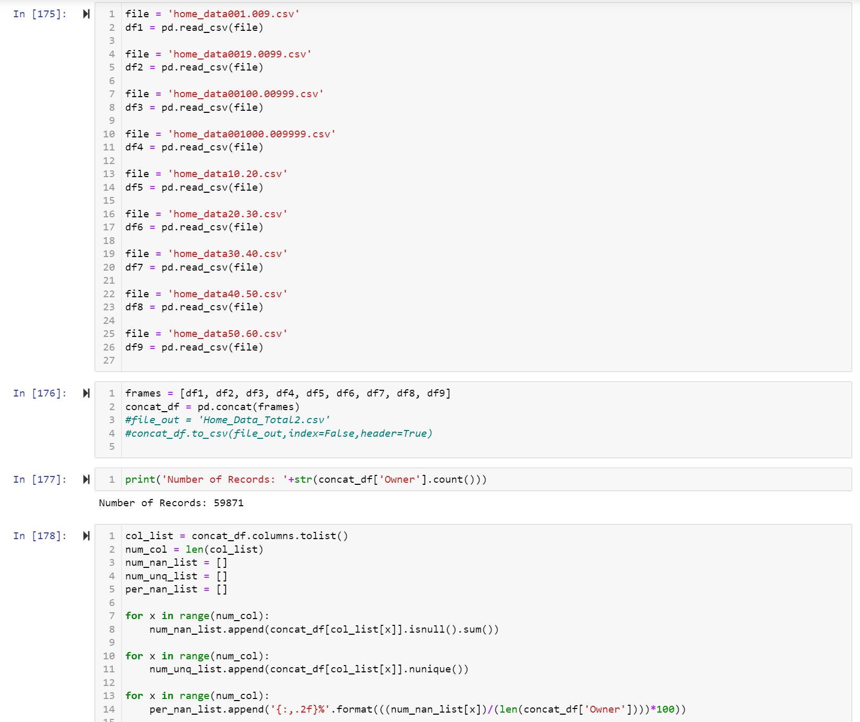
CLEANING THE DATA
DATA CLEANSING METHODS
Working Process
Andrew to Insert Picture here
FORMAT THE SIZE TO THE DETAILS BELOW FOR CONSISTENCY
Size 4.19 x 4.98
DATA SOURCE & SCRAPPING PROCESS
Dropped the following:
rows missing Midland value in city
rows missing home size attributes
rows only featuring home residence attributes
Rows with $0/null values
Historically low values
Added the following:
Total square footage
Calculate column with Total Value/Total Square footage

Slide 7
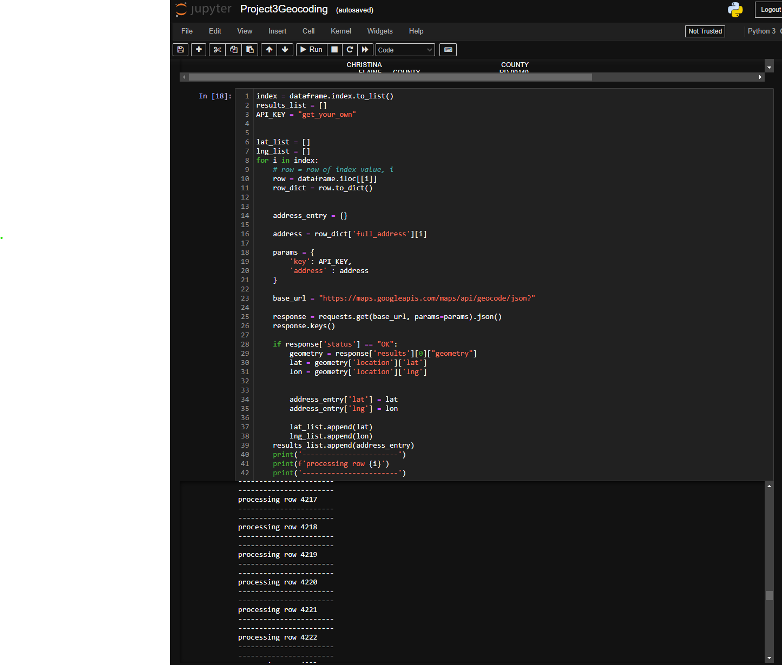
API CALL SETUP
GMAPS API CALL
Insert Picture here
FORMAT THE SIZE TO THE DETAILS BELOW FOR CONSISTENCY
Size 4.19 x 4.98
Working Process
GMAPS API CODING PROCESS
Addresses were collected from Clean Dataset
Query URL was created to pass to API
Results were inserted into Clean Dataset and saved.

Slide 8
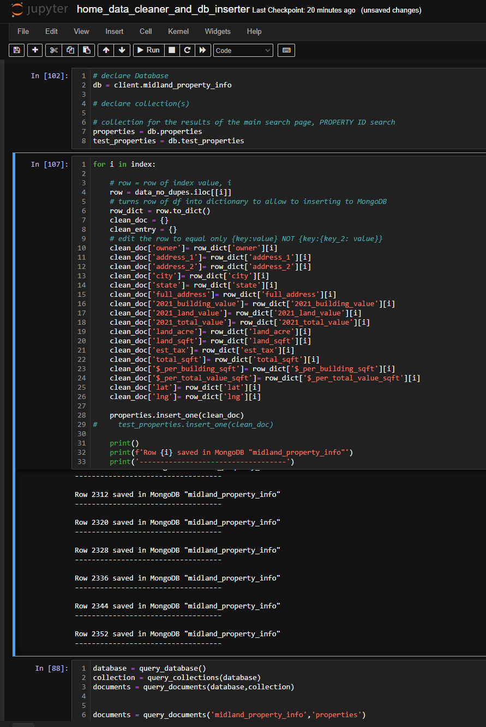
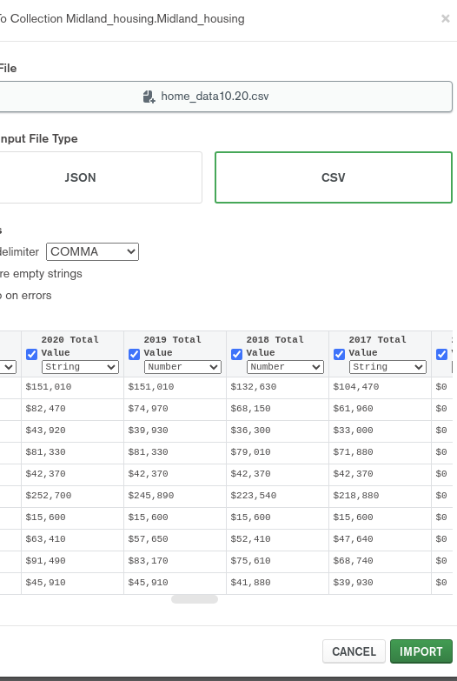
CREATING A DATABASE USING MONGODB

Slide 9
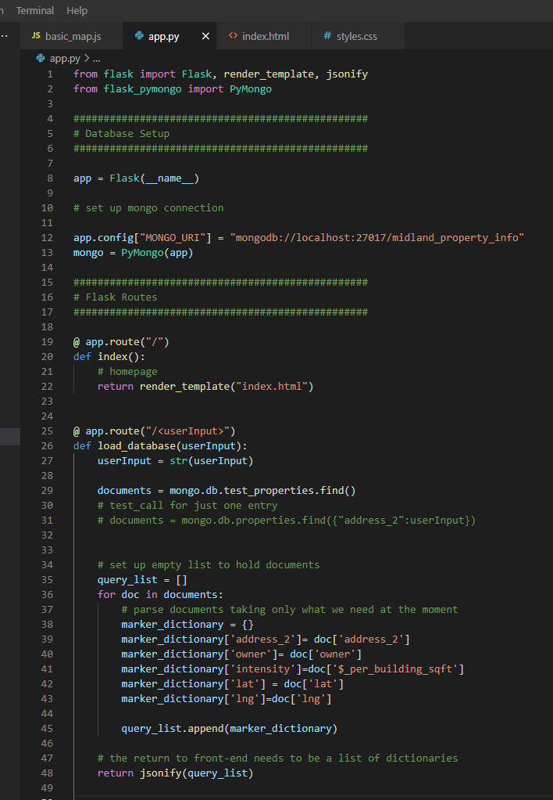
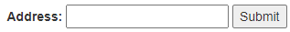
Connecting the data
Parsing & Database Setup – Back end Data Collection
Working Process
PARSING & API SETUP
Database Type And Layout Is Observed.
Front-end Communication Is Developed
Search Parameters Are Formed ("/<userInput>")
Data is Retrieved via mongoDB .find() Method
Information Is Then Passed To Front-end

Slide 10
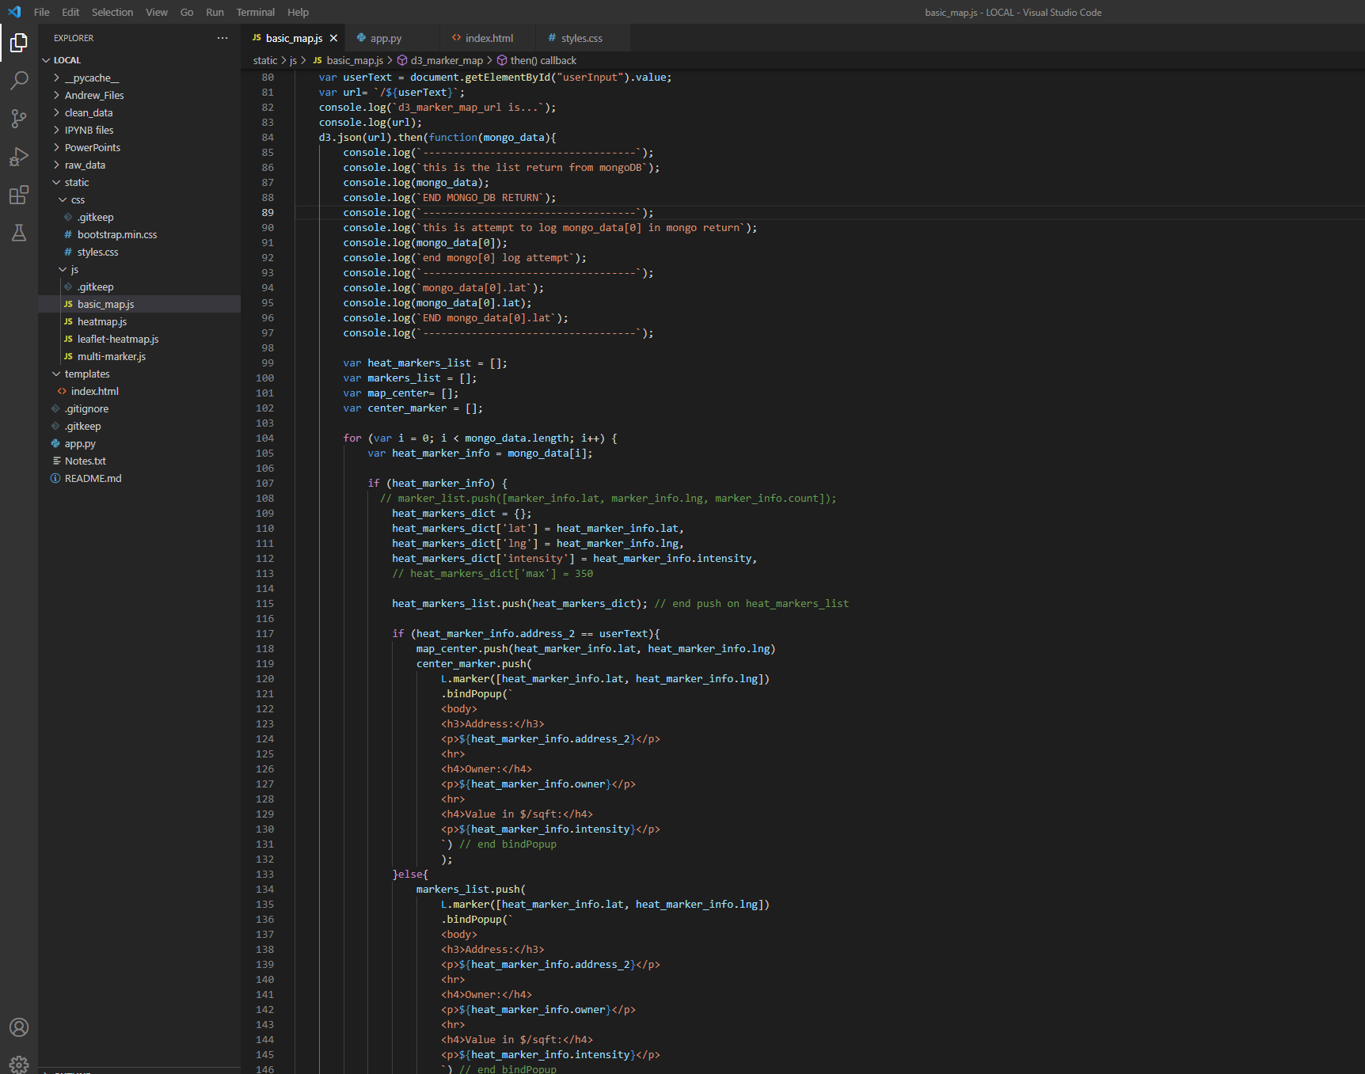
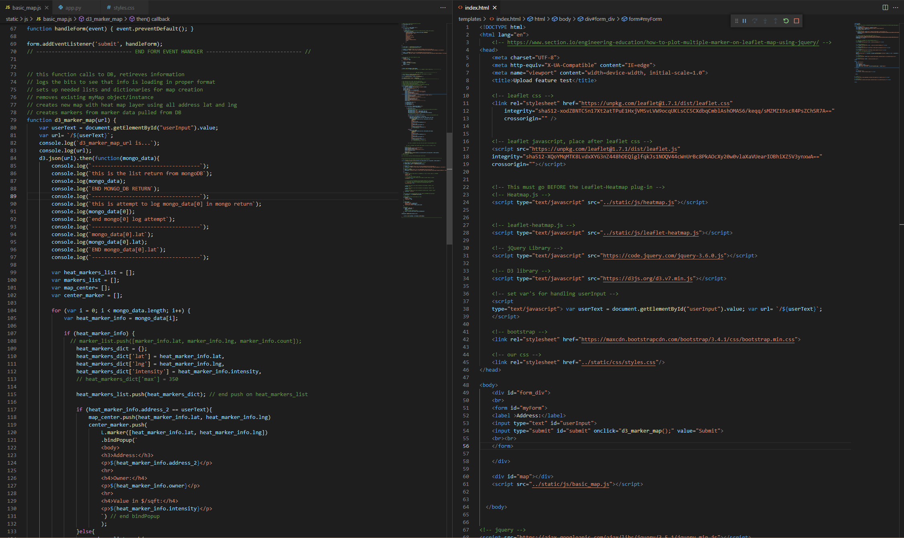
Connecting the data
From Flask to Front-End
Working Process
FRONT-END DATA MANIPULATION
Data Is Dissected
Containers/Lists Are Made To Hold Various Data
Data Is Used To Generate Markers
Markers Are Passed Through Leaflet & Leaflet-heat
Interactive Map Is Displayed To User With Requested Information

Slide 11
Key Points to leaflet MAP CREATION
Below are a few key points to the map creation process
Key Point 01
Key Point 02
Key Point 03
Consider Concept
Obtain Useable Data
Aggregate and Clean the Data to form Dataset
Key Point 04
Key Point 05
Key Point 06
Establish a Database
Back-End
Connect to Database (API)
Front-End
Create JS Application to Perform Function(s)
Key Point 07
Key Point 08
Key Point 09
Connect Front and Back-End
Pass Information Across Pipeline for Application Testing
Display Finished, Working Product

Slide 12
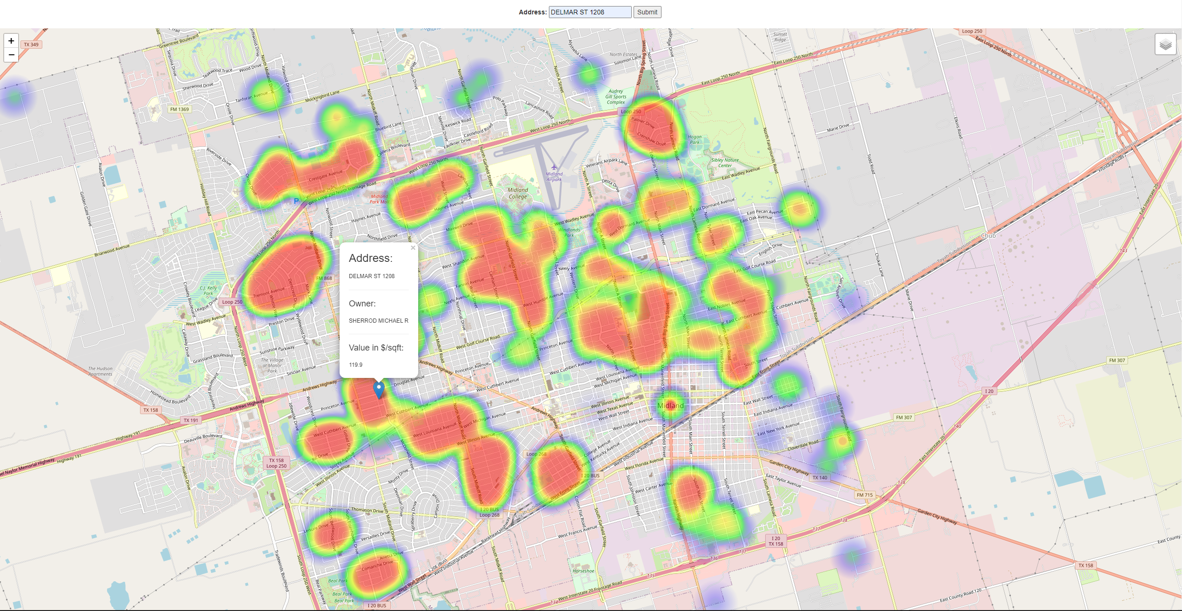
FINDINGS

Slide 13
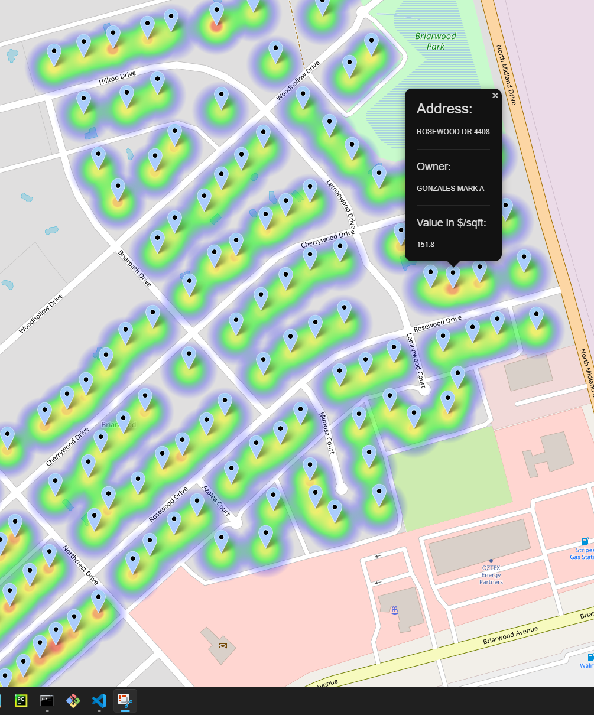
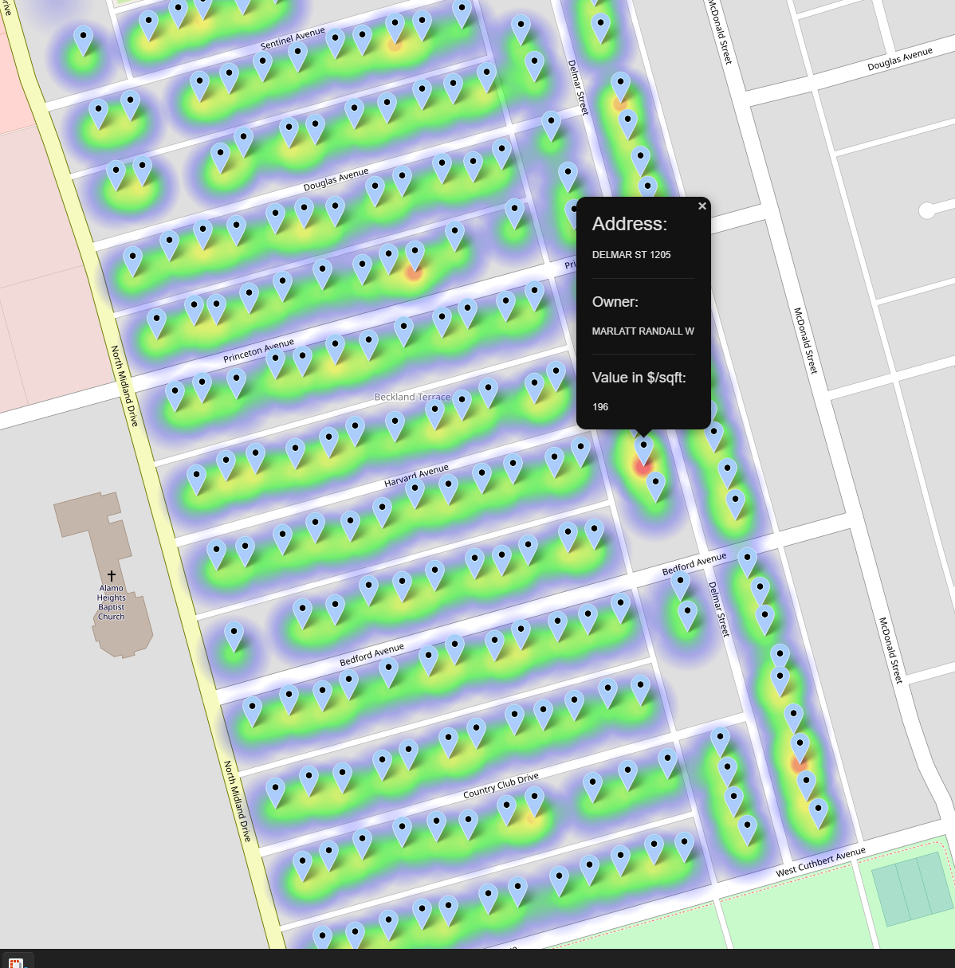
CHALLENGES AND SUGGESTIONS

Slide 14
Challenges
Below are some challenges faced during the project
Missing data in records
asynchronous Loading
Of the 60,000 records scraped only 6442 records made it to the final data set. After dropping additional data that we couldn’t use we ended up with 6051 records.
The Front End construction was conquered gradually to ensure that the application would request and load info as desired.
Initial data size
Code communication
The size of the data made the initial scrape cumbersome as it took a long time to scrape the 60,000 records from the Midland County db. We had to break the scrape and CSV files into 7 different jobs for it to be manageable.
The code needed to communicate with the front and back end without hang-ups to ensure the application would run as desired.

Slide 15
Map findings
Key Take-Aways
Property location
price
Findings
01
Centered on the cluster
Highest priced homes in the cluster
Trends
While the maps did show a variance is price by the color density displayed on the distribution did not show the disparity across the areas examined, we thought it would. It was an even distribution in the price distribution across all clusters of properties analyzed.
Findings
The clusters of properties analyzed showed a consistent pattern with the most expensive homes being in the middle of the distribution and the price range progressively getting to the lower end of the spectrum as we get to the outskirts of each cluster.
outskirts of the cluster
Middle of the price distribution in the cluster
02
03
Outside end of the cluster
Lower end of the price distribution in the cluster

Slide 16
QUESTIONS

